Slide 1

BUBBLE SORT
Dr. Ashish Sharma
Dept. of CEA, GLA University, Mathura

Slide 2
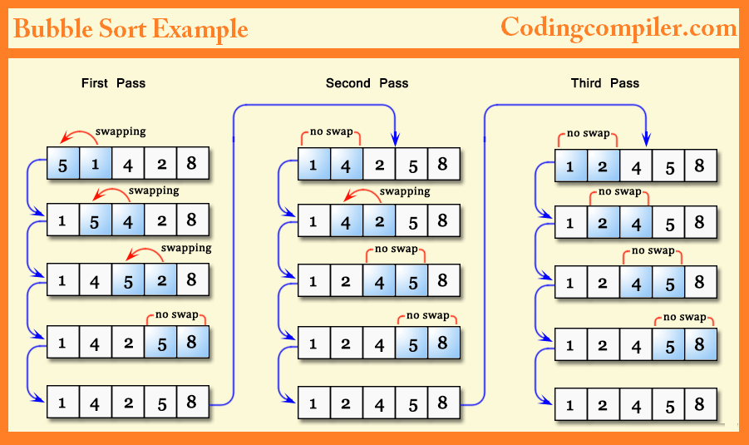
Example

Slide 3
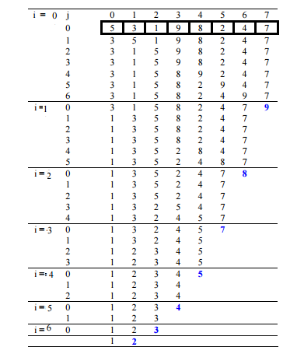
Example

Slide 4
Program
def bubbleSort(arr):
n = len(arr)
for i in range(n):
for j in range(0, n-i-1):
if arr[j] > arr[j+1] :
arr[j], arr[j+1] = arr[j+1], arr[j]
arr = [12, 1, 25, 50, 27, 15, 23]
bubbleSort(arr)
print ("Sorted array is:")
for i in range(len(arr)):
print ("%d" %arr[i])

Slide 5
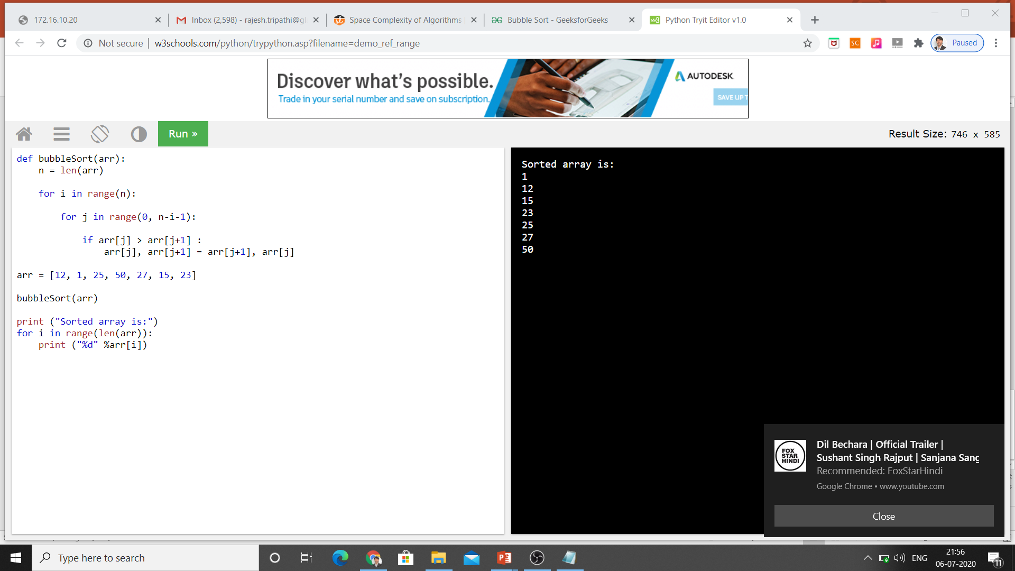
Algorithm

Slide 6
Thank You Keep Learning…

